Slide 1
Health Insurance Cross Sell
Samuel P. Sears

Slide 2
Background
Cross-sell: When a company sells additional products to an existing customer
Examples:
Retailer asking you if you want to buy insurance on the product you’re purchasing
Restaurant asking if you would like fries with your burger
A car dealer asking if you would like to purchase vehicle add-ons at the time of purchase
This Project:
An insurance company cross-selling vehicle insurance to existing health insurance customers

Slide 3
The Problem with Cross-Selling Insurance
How it’s typically done
Ad hoc conversations between CSRs or producers and the customer
Problems
Company does not reach all customers interested in vehicle insurance
Reaching out to all customers may not be feasible
Need
Identify interested customers for targeted cross-selling

Slide 4
The Data
Kaggle - Health Insurance Cross Sell Prediction
Variable | Gender | Age | Driving License | Region Code | Previously Insured | Vehicle Age | Vehicle Damage | Annual Premium | Policy Sales Channel | Vintage
Type | Categorical | Numerical | Categorical | Categorical | Categorical | Categorical | Categorical | Numerical | Categorical | Numerical
Values | Male Female | 20 … 85 | Yes No | 0 to 52 | Yes No | < 1 year 1-2 years > 2 years | Yes No | 2,630 … 540,165 | 1 … 163 | 10 … 299
Description | Gender | Age | Does customer have a driver’s license? | Customer region | Does customer have vehicle insurance? | Age of customer’s vehicle | Does customer’s vehicle have damage? | Health insurance annual premium | Sales channel customer belongs to | How long customer has been associated with company?
Response
Categorical
Yes No
Is customer interested in vehicle insurance?
381,109 existing health insurance customers
12.3% interested in vehicle insurance

Slide 5
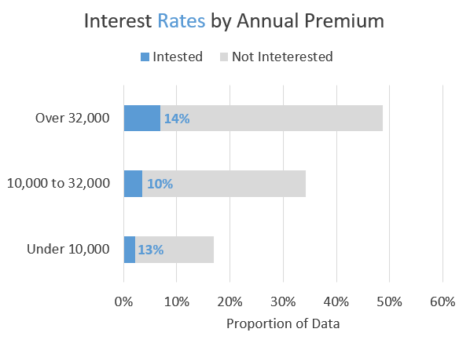
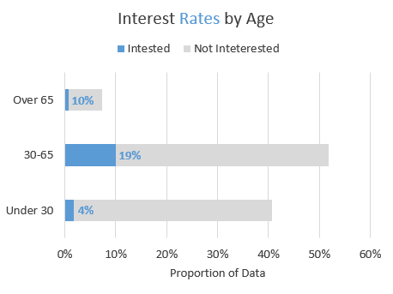
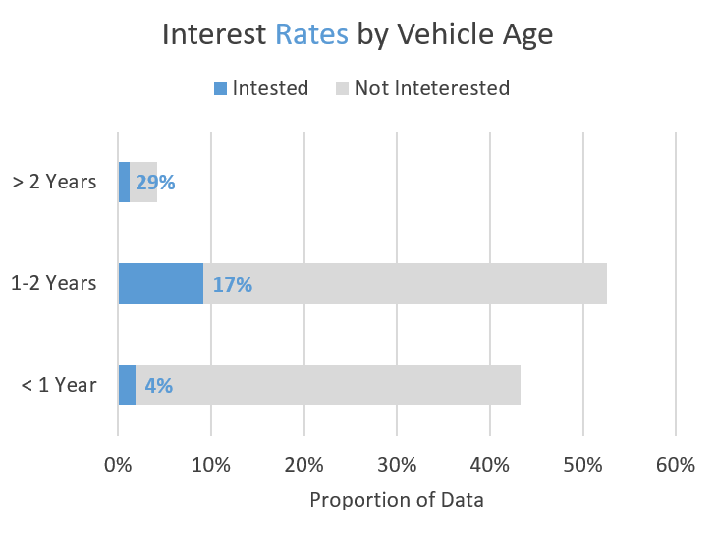
Insights from Data Exploration

Slide 6
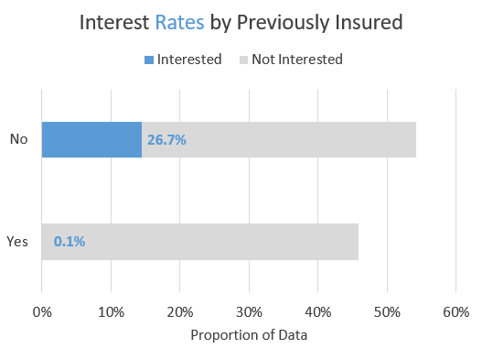
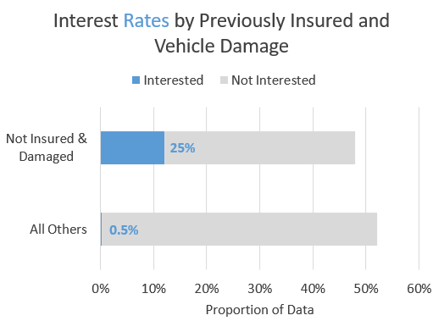
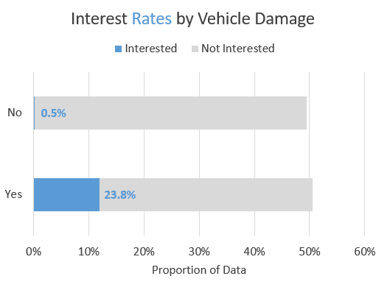
Insights from Data Exploration

Slide 7
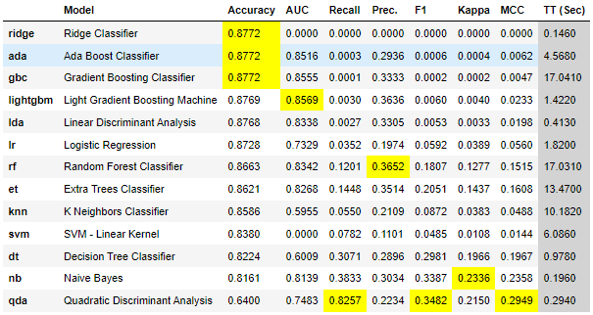
Predictive Modeling
Problem: Unbalanced Data
Accuracy of 87.7% can be achieved by always predicting not interested which provides no value
Solutions
Evaluate on AUC
Light Gradient Boosting Machine using SMOTE oversampling
Neural Network using Class Weights

Slide 8
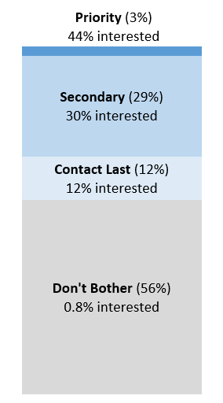
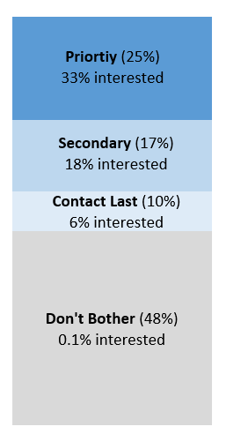
Proposed Solution – Customer Segmentation with Model Probabilities
Model Option 1: Light Gradient Boosting Machine
Model Option 2:
Neural Network
Probability | Interval Total | Interested | Not Interested
0.9-1.0 | 0 | 0 | 0
0.8-0.9 | 0 | 0 | 0
0.7-0.8 | 0 | 0 | 0
0.6-0.7 | 0 | 0 | 0
0.5-0.6 | 14 | 6 | 8
0.4-0.5 | 2921 | 1302 | 1619
0.3-0.4 | 17718 | 6123 | 11595
0.2-0.3 | 15384 | 3910 | 11474
0.1-0.2 | 14202 | 2059 | 12143
0.0-0.1 | 64094 | 544 | 63550
Probability | Interval Total | Interested | Not Interested
0.9-1.0 | 0 | 0 | 0
0.8-0.9 | 3561 | 1460 | 2101
0.7-0.8 | 15702 | 4998 | 10704
0.6-0.7 | 6511 | 1428 | 5083
0.5-0.6 | 3734 | 608 | 3126
0.4-0.5 | 2983 | 325 | 2658
0.3-0.4 | 2752 | 237 | 2515
0.2-0.3 | 2583 | 138 | 2445
0.1-0.2 | 2184 | 62 | 2122
0.0-0.1 | 36212 | 58 | 36154

Slide 9
Project Repository
https://github.com/ssears219/Health-Insurance-Cross-Sell-Prediction

